Slide 1

OT LABORATEGI BIRTUALAK
4.-PLC Siemens Birtuala
(Tia Portal+PLCSIM+NetTOPLC > Keepserver > Factory)
Notes:
n

Slide 2

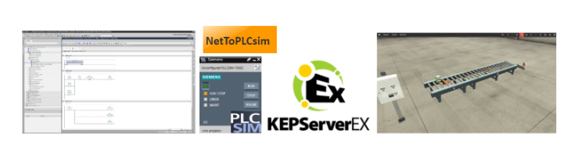
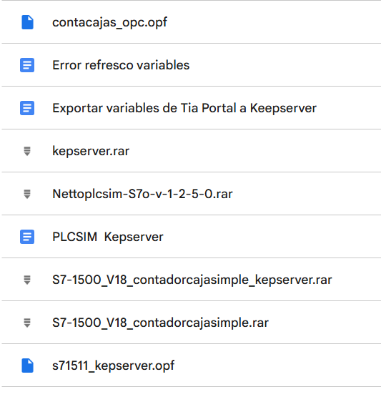
4.-PLC Siemens Birtuala
(Tia Portal+PLCSIM+NetTOPLC > Keepserver > Factory)
Konpartitutako fitxategiak:
Tia Portal proiektua V18. Factory IO eszenatoki sinplea.
Kepserver fitxategia
Kepserver , NetToPLC instalableak

Slide 3
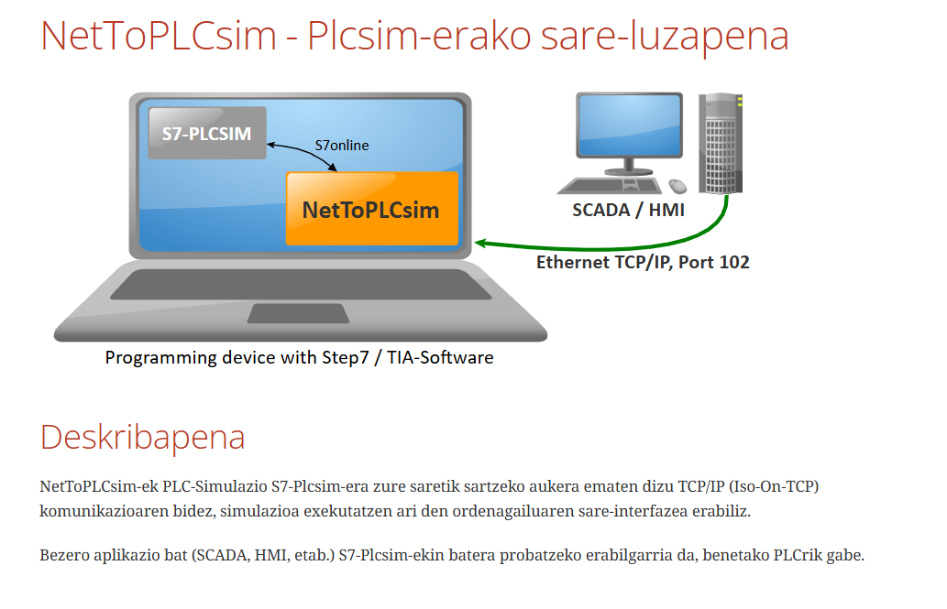

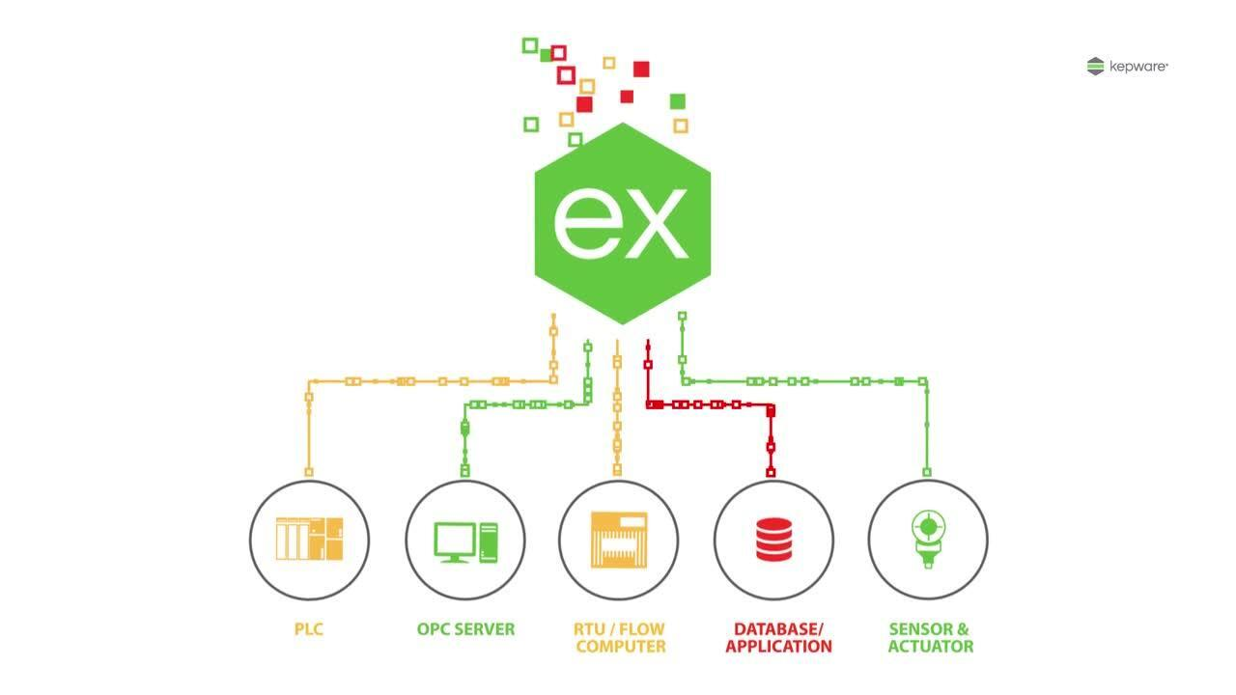
4.-PLC Siemens Birtuala
(Tia Portal+PLCSIM+NetTOPLC > Keepserver > Factory)
1- Tia Portal ireki
2- NetToPLCsim ireki ,ez konfiguratu
3- PLCSIM exekutatu Tia Portal bidez
4- NetToPLCsim konfiguratu , abiatu
5- Factory erabili
Descarga
Descarga

Slide 4
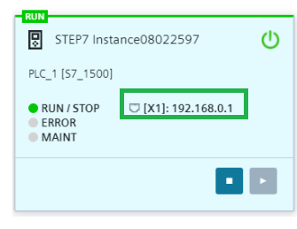
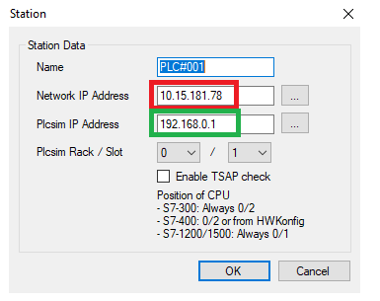
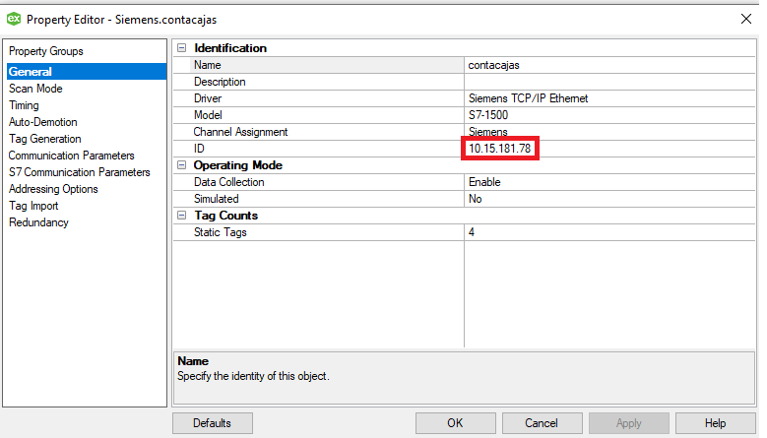



4.-PLC Siemens Birtuala
(Tia Portal+PLCSIM+NetTOPLC > Keepserver > Factory)

Slide 5
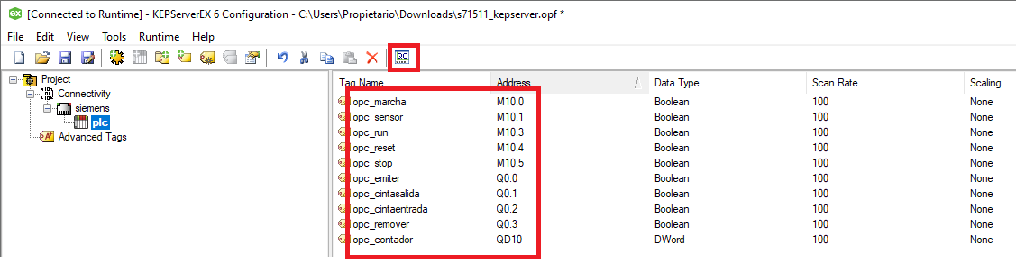
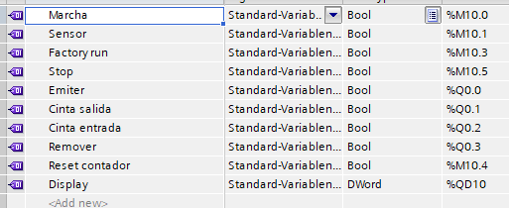
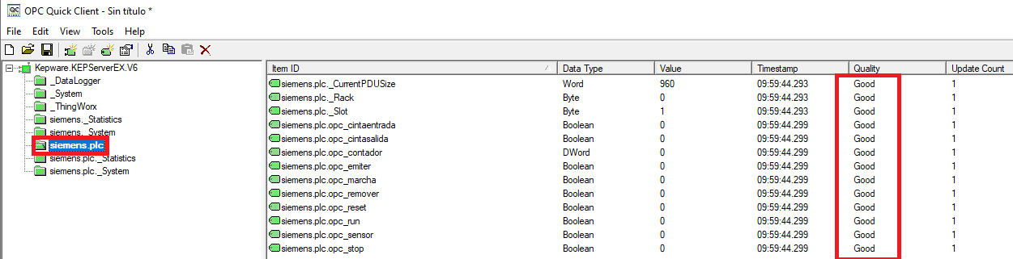
4.-PLC Siemens Birtuala
(Tia Portal+PLCSIM+NetTOPLC > Keepserver > Factory)

Slide 6
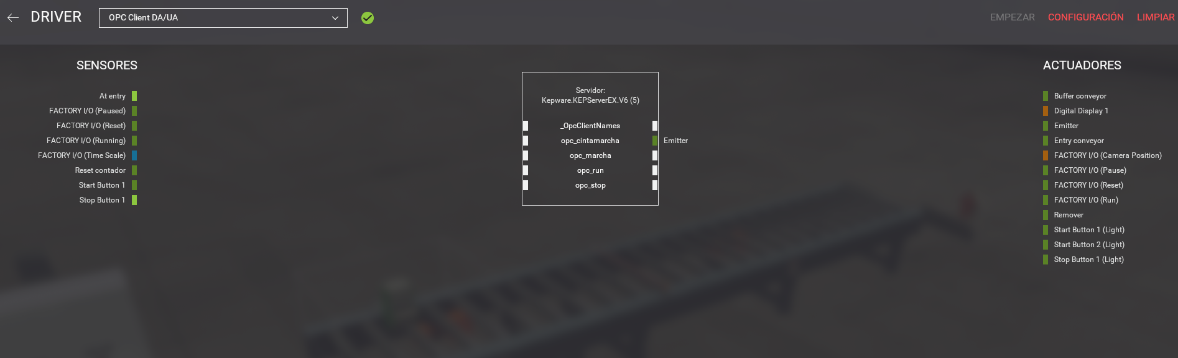
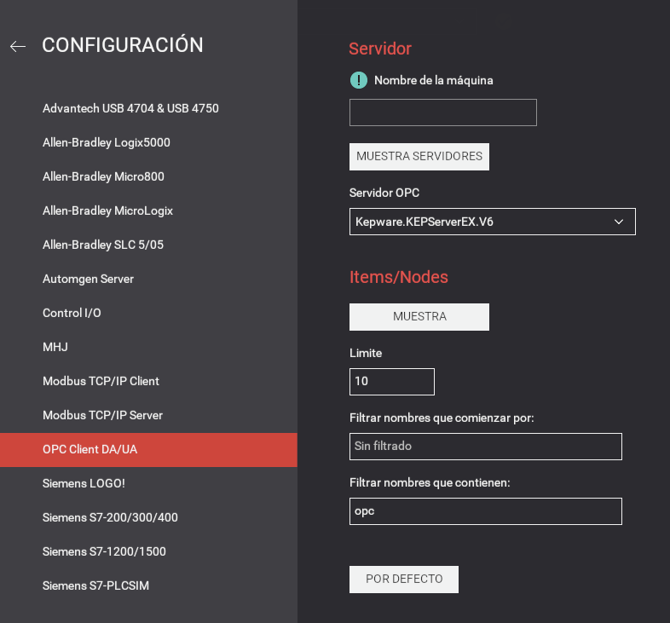
4.-PLC Siemens Birtuala
(Tia Portal+PLCSIM+NetTOPLC > Keepserver > Factory)

Slide 7
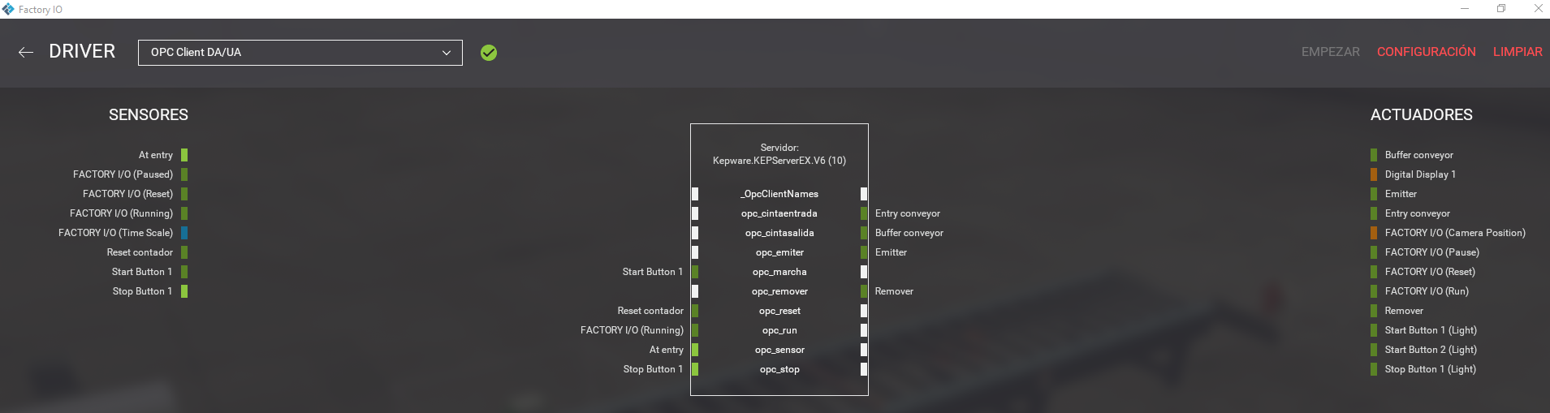
4.-PLC Siemens Birtuala
(Tia Portal+PLCSIM+NetTOPLC > Keepserver > Factory)

Slide 8
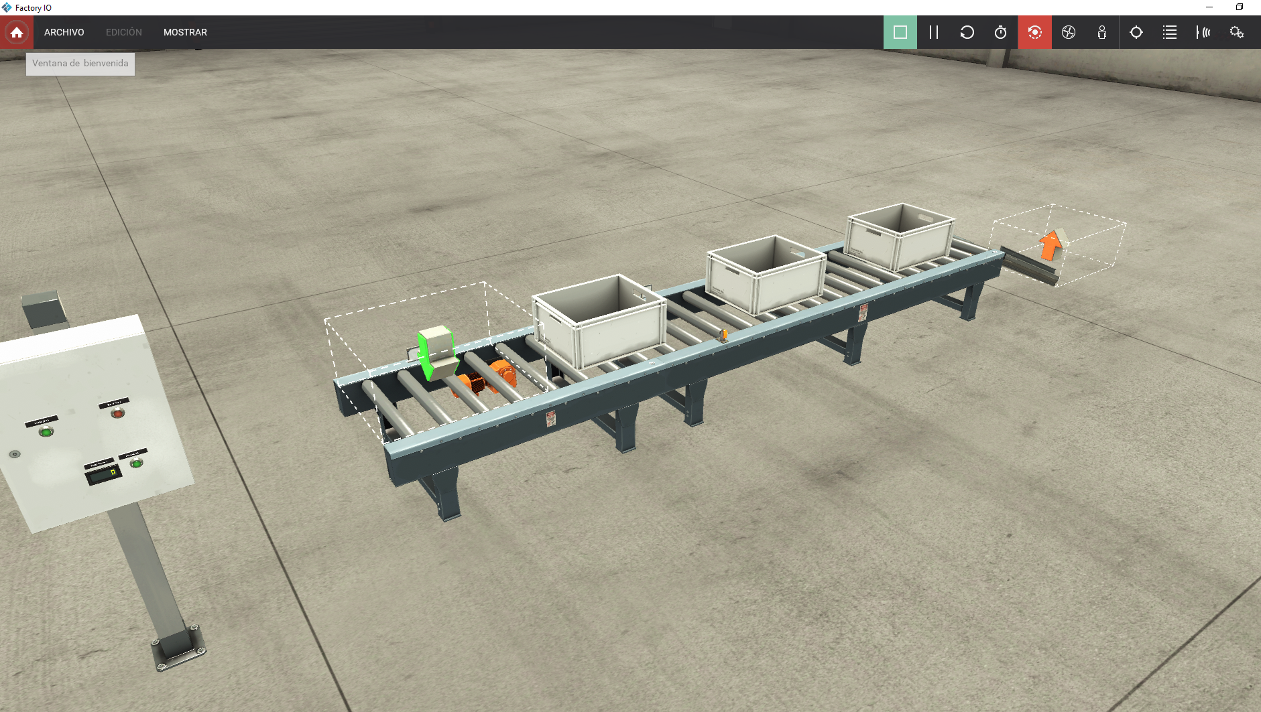
4.-PLC Siemens Birtuala
(Tia Portal+PLCSIM+NetTOPLC > Keepserver > Factory)

Slide 9
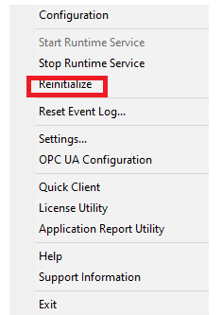
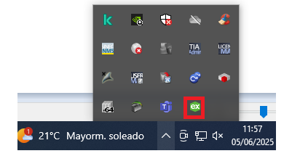

5. PLC Sare birtuala (3 Tia Portal+PLCSIM+NetTOPLC + 3 Codesys > Keepserver > Factory)
Kepserver mugatua (+- 3 ordu; Berrabiarazi)

Slide 10
Ingurune desberdinak eta ezaugarriak
PLC Siemens sare Birtuala (3 Tia Portal+PLCSIM+NetTOPLC > Keepserver > Factory)

Slide 11
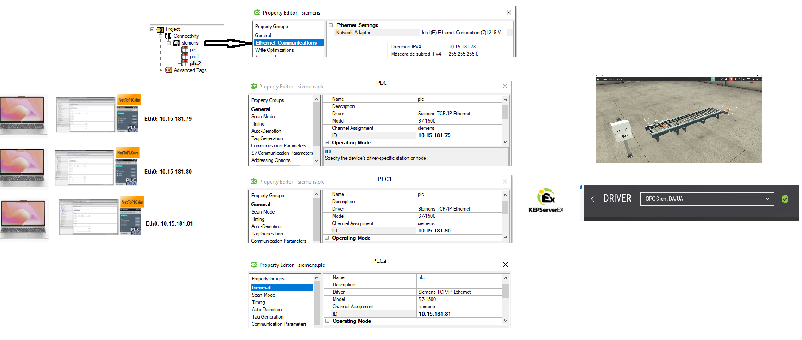
Ingurune desberdinak eta ezaugarriak
PLC Siemens sare Birtuala (2 Tia Portal+PLCSIM+NetTOPLC > Keepserver > Factory)
Egin ????

Slide 12
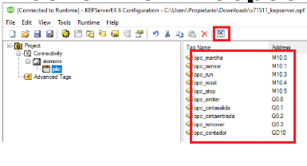
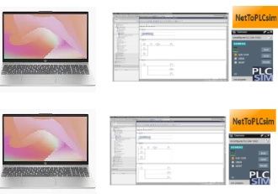
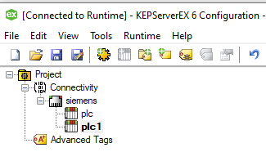
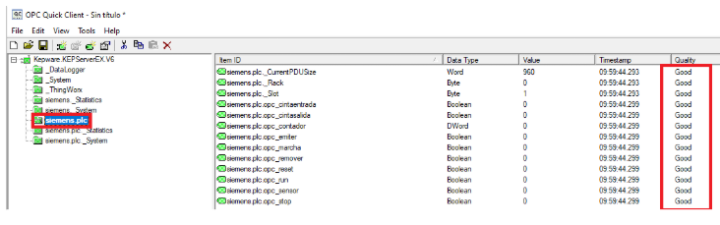
Ingurune desberdinak eta ezaugarriak
PLC Siemens sare Birtuala (2 Tia Portal+PLCSIM+NetTOPLC > Keepserver > Factory)
Egin ????

Slide 13
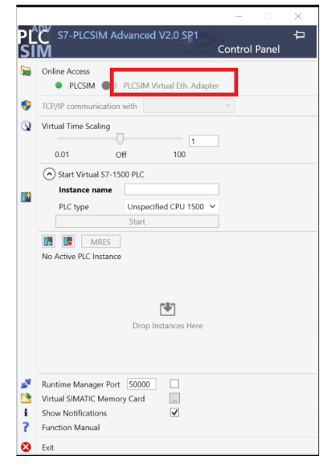
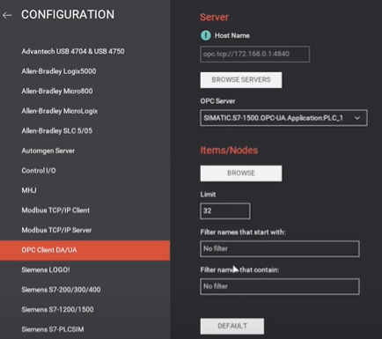
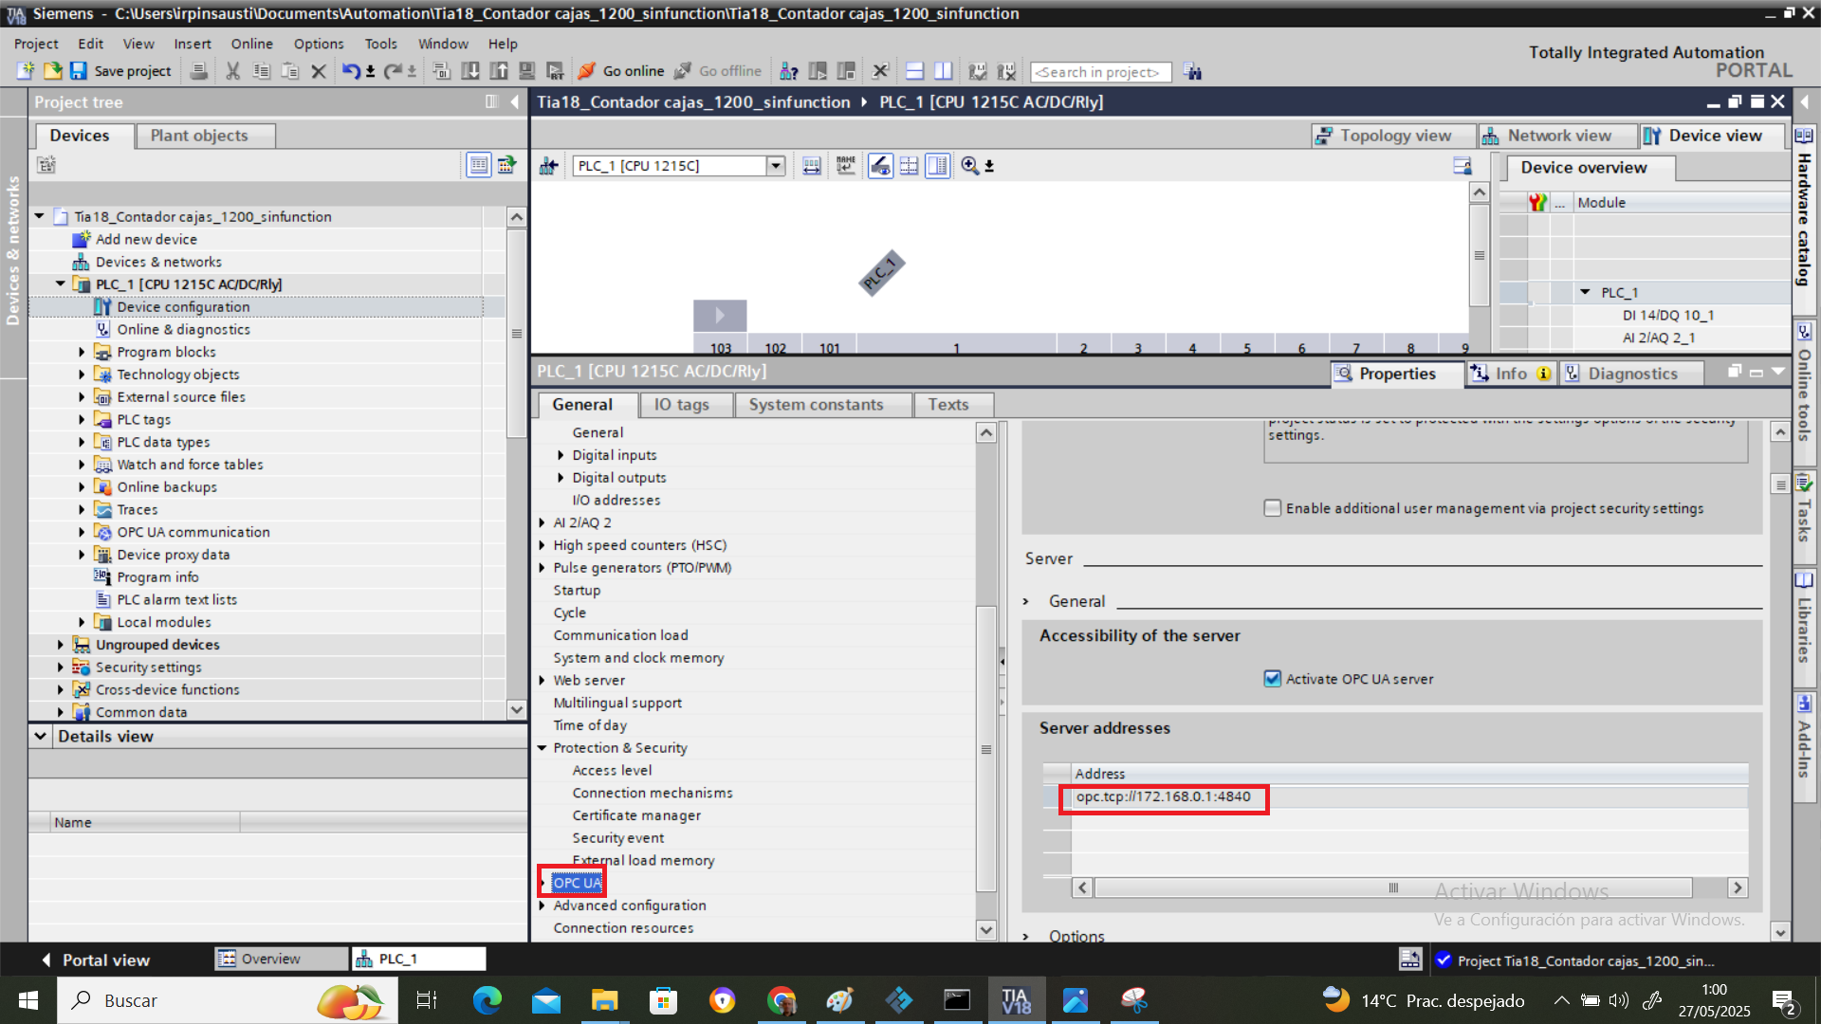
3.-PLC Siemens Birtuala (Tia Portal+PLCSIM > Factory)
3.4 PLC Siemens sare Birtuala ( Tia Portal OPC server+PLCSIM Advance > Factory client)
*Ez da frogatu
Video
PLCSIM ADVANCE

